Slide 1
Arts of Resistance in South Africa
Drama
Popular Theater in South Africa

Slide 2
A Quick look at South Africa – during the last years of European Rule
Apartheid was a legal system of institutionalized racial segregation that existed in South Africa from 1948 until the early 1990s.
After the National Party gained power in South Africa in 1948, its all-white government immediately began enforcing law after law restricting the movement and rights of “Black” South Africans.

Slide 3
See the youtube videos:
Apartheid Explained (only 2:53 mins)
https://www.youtube.com/watch?v=S7yvnUz2PLE
APARTHEID 46 YEARS IN 90 SECONDS - BBC NEWS
https://www.youtube.com/watch?v=2f2k6iDFCL4

Slide 4
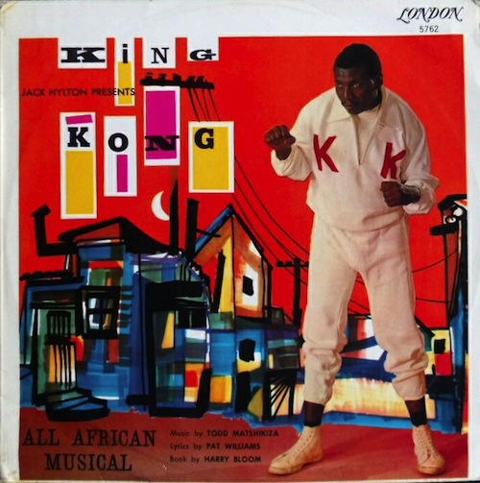
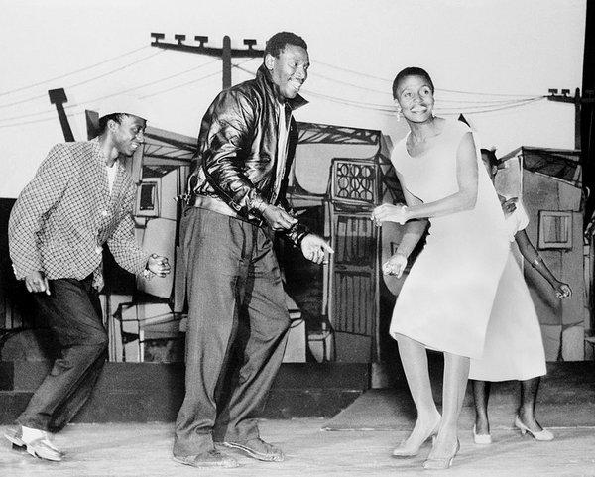
one of the first activist plays in South Africa was a jazz opera (Late 1950s)
King Kong (1959) based on a book by Harry Bloom.
Music and lyrics by Todd Matshikiza.
This was a jazz opera that put life in the black townships on stage.
King Kong had a large, all-black cast; 72 people.
Portrayed the life and times of a heavyweight boxer.

Slide 5
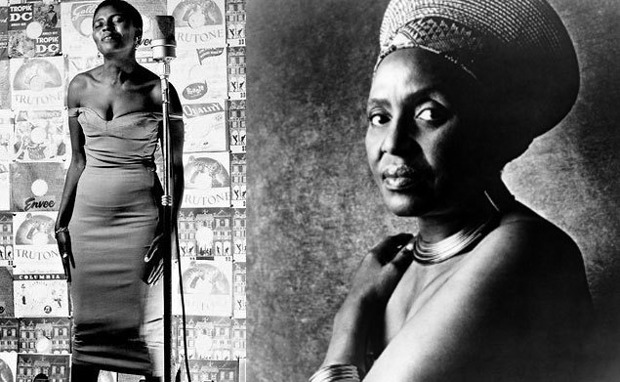
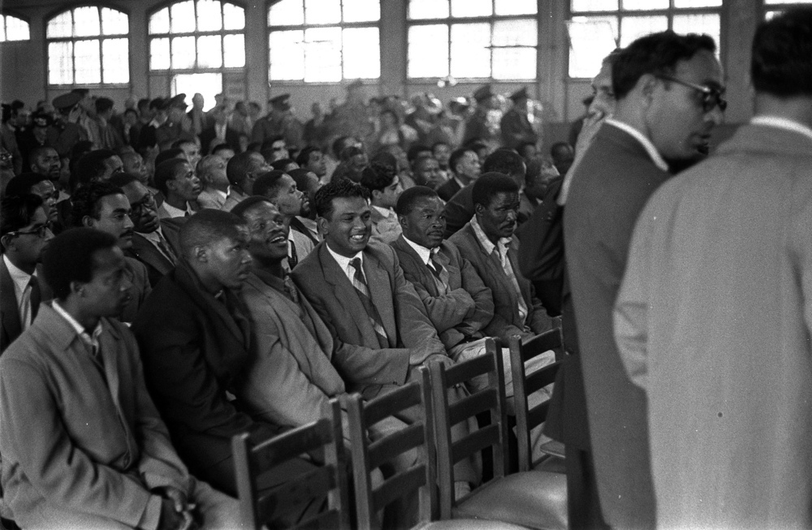
King Kong opera
Launched the international career of singer, Miriam Makeba, who played the owner of a well known saloon in Sophiatown.
The song Sad Times, Bad Times was a reference to the infamous South African Treason Trial that took place over 4 years in Pretoria acquitting African National Council leaders, including Nelson Mandela.
https://www.youtube.com/watch?v=-aGK1sM77Z8

Slide 6
Important Laws in South Africa affecting theater…
A system of censorship laws (from 1930s) were revived and became more rigorous in 1963 under the Publication Control Board who created the…
1963 Publication and Entertainment ACT (replaced again in 1974).
this law stated that artistic works, like plays could be deemed ‘undesirable’, and
Plays could be officially banned from being produced or performed.

Slide 7
Important Laws in South Africa affecting theater…
Group Areas ACT used to enforce segregation in all theatres. This was prompted by a nation wide clampdown on all political opposition.
Playwrights boycotts-deprived management co. and the Performing Arts Council in South Africa to commercially produce overseas hits.
Copyright ACTS – made it legal to steel or change texts by foreign playwrights, if those playwrights in opposition to apartheid refused to allow their works to be shown in South Africa.
Many theaters in South Africa, rebelled against them, were sympathetic to writers and playwrights and took risks against these kinds of legislation.
Notes:
“ The Last Bastion Under Seige” by Anthony Akerman (pp. 50-57) from Culture in Another South Africa..

Slide 8
Township Plays and/or Statement Theatre
Is a type of dramatic play
Inspired by the everyday life of urban Black South Africans
These plays provided a voice for the voiceless
Produced and performed in the townships and in alternative theaters.
Or very simple productions, with only one night in a town. (“one night stands”).

Slide 9
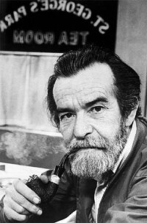
Playwright:
Harold Athol Lanigan Fugard
Born 1932 grew up in St. Elizabeth
His parents were English and Afrikaans
Had various jobs-observed injustice due to apartheid
Social Injustice became a theme in many of his plays

Slide 10
Athol Fugard’s works
Athol organized a multiracial theater – and he called it "The Rehearsal Room”
Soon became the South Africa’s premier playwright
Subjects: Contemporary South Africa and the psychological and physical barriers confronted in trying to overcome Apartheid.
Many of his plays were officially banned by the South African government.

Slide 11
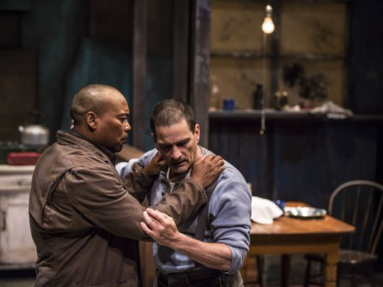
The 1960s
The Blood Knot (1961) by Athol Fugard was the first play to confront audiences with the “race issue”.
After his play, "Blood Knot" (1961) was produced in England, the government withdrew his passport for four years.
His support in 1962 of an international boycott against the South African practice of segregating theatre audiences led to further restrictions on him.
Notes:
Fugard’s early play Blood Knot was cause for his passport to be revoked.

Slide 12

Group of Black Actors called: The Serpent Players
New Brighton Township, Port Elizabeth. (1961)
Recruited Athol Fugard as scribe and director
They used improvisation for creating and developing a story
First successful play:
Sizwe Bansi Is Dead
Co-written By Athol Fugard and two grassroot actors: John Kani and Winston Ntshona

Slide 13
The Serpent Players and Athol Fugard
When Fugard joined up with the Serpent players it integrated the company (with whites and blacks working together) which broke Apartheid laws.
Ten years later, inspired by a photograph of a black man holding a pipe in one hand and a cigarette in the other, John Kani, Winston Ntshona, and Fugard they all created the play: Sizwe Banzi is Dead.
First produced the play privately so as to avoid trouble with the law.
Started performing it publicly, but only in one-night stands, in order to stay ahead of the police.
Notes:
Read more: http://blogcritics.org/culture/article/theater-review-nyc-sizwe-banzi-is/#ixzz1cYKJfIyJ
(their first performance was in the former snake pit of a zoo, hence the name).

Slide 14
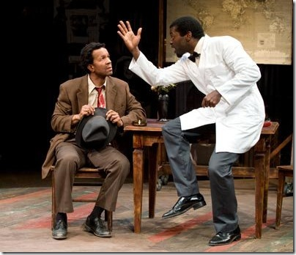
Sizwe Banzi is Dead - by Athol Fugard
Simple in design
Three characters (played by 2 actors)
Only had essential props, costumes and a variety of hats
Style: poetic, Use of absurd situations, comic and serious
Interactive: actors address the audience directly

Slide 15
Production history:
Sizwe Bansi is Dead
Grass roots performances in the townships, 1974 went on to national stages first to deput in Cape Town, South Africa, then on to London and the U.S.
Universal themes of identity; timely issue
Demands a lot of the actors; (received respect all over the world)
Received numerous awards
Voted Best New Play by London critics (1973)
Won Tony Awards in the U.S. for Best Play, Best Actor in a Play; Nominated for Best Director (1974)

Slide 16
South African Plays
The next slides just present background information on the theater scene into the 1970s and 1980s including a short list of other anti-apartheid plays

Slide 17
Important showcase for mixed audiences, unsubsidized theatre (1970s)
Alternative theatres sprung up in the 1970s.
Some plays were sponsored at Universities
“The Space” in Capetown (was founded by Brian Astbury in 1972, Athol Fugard staged plays there)
The Market Theatre in Johannesburg (was founded by Mannie Manim and Barney Simon in 1976)
This theater operated as a ‘club’ with a membership of mixed race audiences. Very controversial.
Rather than being a public space, this club status was able to create a loop hole in the Group Areas Act for mixed audiences.

Slide 18
1980s and other
“anti-apartheid plays” by other authors
Adapt or Die
Asinamali
Bopha!
District Six
Sarafina! (made into a movie 1994)
Sophiatown
Strike the Woman
Performed on stages all over the world……..

Slide 19
Questions to answer on the filmed version of the play Swize Bansi is Dead see assignment instructions…
1. What might this play mean to those who live in the townships?
(Think of the time, their circumstances, and the many restrictions placed upon blacks in South Africa)
2.Based on the second half of the play, what do you think of Swize Bansi’s dilemma, and what would you do?

